Slide 1
9/28/2022

Slide 2
3.5 Review

Slide 3
Operator Associativity
On the cafeteria repl.it, some students wrote code like this:
if (food1.isFruit() || (food2.isFruit() || (food3.isFruit() || (food4.isFruit() || food5.isFruit())))) { … }
Understandable… all our examples of && and || showed only two operands!
It is legal, however, to chain || together:
if (food1.isFruit() || food2.isFruit() || food3.isFruit() || food4.isFruit() || food5.isFruit()) { … }

Slide 4
Operator Associativity
&& and || are defined as having two operands. The && and || operators are left associative.
What is the meaning of left-associative?
Left-associative operators of the same precedence are evaluated in order from left to right. For example, addition and subtraction have the same precedence and they are left-associative.
In the expression 10-4+2, the subtraction is done first because it is to the left of the addition, producing a value of 8.
10-4+2 is equivalent to (10-4)+2, not 10-(4+2).
food1.isFruit() || food2.isFruit() || food3.isFruit() || food4.isFruit() || food5.isFruit()
(food1.isFruit() || food2.isFruit()) || food3.isFruit() || food4.isFruit() || food5.isFruit()
((food1.isFruit() || food2.isFruit()) || food3.isFruit()) || food4.isFruit() || food5.isFruit()
(((food1.isFruit() || food2.isFruit()) || food3.isFruit()) || food4.isFruit()) || food5.isFruit()

Slide 5
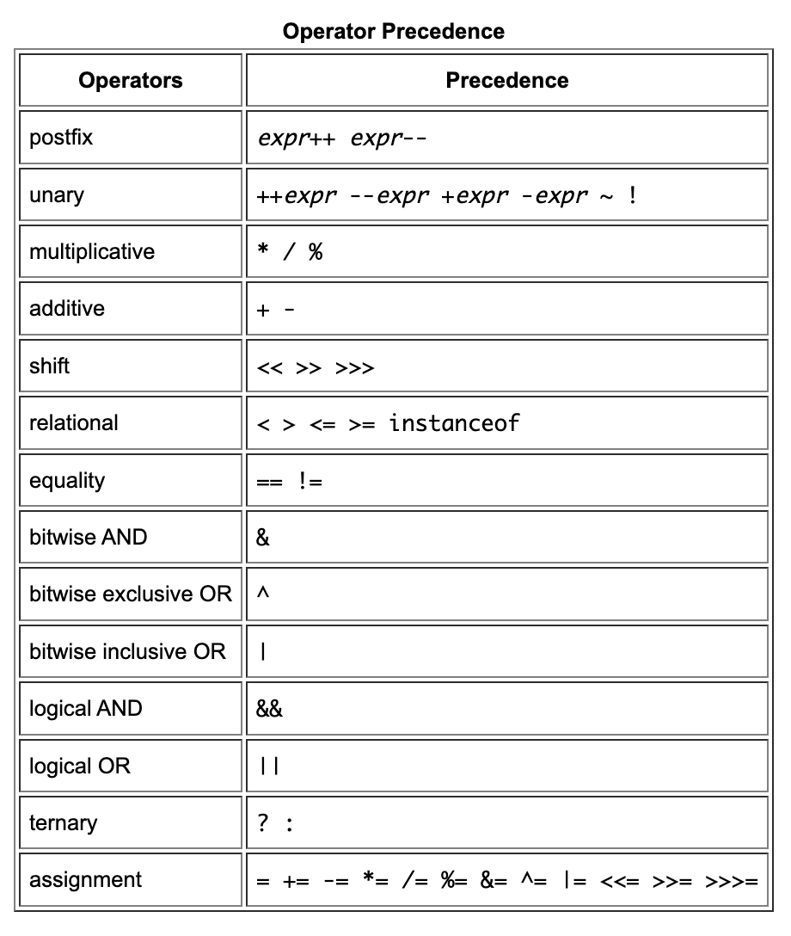
Operator Associativity and Precedence
What does this do?
hasTicket || onGuestList && standingInLine
&& has higher precedence, so this is equivalent to
hasTicket || (onGuestList && standingInLine)
but probably what you want is
(hasTicket || onGuestList) && standingInLine
… which means something very different.
Use parentheses when needed!

Slide 6
Returning Boolean Expressions
A lot of students wrote code like this:
if (hasFruit() && hasVegetable() && hasGrain() && hasDairy() && hasProtein()) { return true; } else { return false; }
This works fine, but you can just return a boolean expression:
return hasFruit() && hasVegetable() && hasGrain() && hasDairy() && hasProtein();
Odd but true: return doesn't require parentheses, but if does.

Slide 7
3.6
Equivalent Boolean Expressions

Slide 8
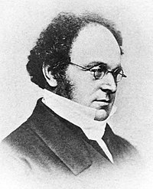

De Morgan's Laws
Augustus De Morgan (27 June 1806 – 18 March 1871) was a British mathematician and logician. He formulated De Morgan's Laws.

Slide 9
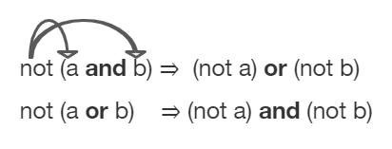
DeMorgan's Laws
Rules by which we can simplify Booleans to make them easier to read or interpret

Slide 10
DeMorgan's Laws
In Java:
!(a && b) is equivalent to !a || !b
!(a || b) is equivalent to !a && !b

Slide 11


DeMorgan's Laws
!(a && b) is equivalent to !a || !b
There are not both cats and dogs here.
There are not cats here, not dogs here, or both.
!(cats && dogs)
!cats || !dogs
cats true
dogs true
!(cats && dogs) false
!cats || !dogs false
cats true
dogs false
!(cats && dogs) true
!cats || !dogs true
cats false
dogs true
!(cats && dogs) true
!cats || !dogs true
cats false
dogs false
!(cats && dogs) true
!cats || !dogs true

Slide 12
DeMorgan's Laws
!(a || b) is equivalent to !a && !b
There are not cats here or dogs here.
There are not cats here, and there are not dogs here.
!(cats || dogs)
!cats && !dogs
cats true
dogs true
!(cats || dogs) false
!cats && !dogs false
cats true
dogs false
!(cats || dogs) false
!cats && !dogs false
cats false
dogs true
!(cats || dogs) false
!cats && !dogs false
cats false
dogs false
!(cats || dogs) true
!cats && !dogs true

Slide 13
Negated Relational Expressions
For negated relational expressions, you can flip the operator and remove the !
!(c == d) is equivalent to (c != d)
!(c != d) is equivalent to (c == d)
!(c < d) is equivalent to (c >= d)
!(c > d) is equivalent to (c <= d)
!(c <= d) is equivalent to (c > d)
!(c >= d) is equivalent to (c < d)

Slide 14
DeMorgan's Laws
Truth Tables are a way to show that two boolean expressions are equivalent.
You can kind of think of this as a proof, but it also a tool to let you think about booleans more easily.
Let's use truth tables to demonstrate DeMorgan's Laws:
!(a && b) is equivalent to !a || !b
!(a || b) is equivalent to !a && !b
a | b | !(a && b) | !a || !b

Slide 15
DeMorgan's Laws: Exercise
On your own, on pen and paper, use truth tables to check if the following are equivalent:
!(x == 0 || x >= 1) ⇔ !(x == 0) && !(x >= 1)
!(x == 0 || x >= 1) ⇔ x != 0 && x < 1
Can you also demonstrate that the expressions are equivalent using DeMorgan's Laws?
!(a && b) ⇔ !a || !b !(a || b) ⇔ !a && !b

Slide 16
DeMorgan's Laws: Exercise
Use DeMorgan's Laws and flipping operators to simplify the following expressions:
!(x > 2 && y < 4)
!(x == 2 && y > 4)
!(x!=5 && y!=7)
!(x<= 5 && y > 7)
Cheat Sheet:
!(a && b) ⇔ !a || !b !(a || b) ⇔ !a && !b !(c == d) ⇔ (c != d) !(c != d) ⇔ (c == d) !(c < d) ⇔ (c >= d) !(c > d) ⇔ (c <= d) !(c <= d) ⇔ (c > d) !(c >= d) ⇔ (c < d)

Slide 17
3.7
Object Equality

Slide 18
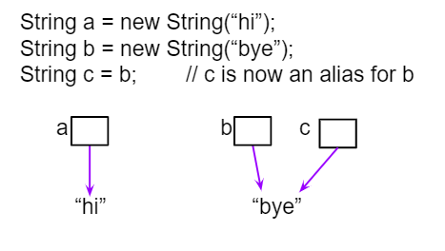
Object/String Equality
System.out.println(c);
System.out.println(b == c);
System.out.println(b.equals(c));

Slide 19
Object/String Equality
String s1 = new String("Hello");
String s2 = new String("Hello");
System.out.println(s1 == s2);
System.out.println(s1.equals(s2));
What's going on in memory here?
What will this code print out?

Slide 20

Object/String Equality
The .equals() method is a special method that all classes can define that decide whether or not an object of that class is equal to something else.
The default implementation of .equals is Object.equals. The documentation says:
This is a lot of fancy talk that basically means Object.equals is this:
The equals method for class Object implements the most discriminating possible equivalence relation on objects; that is, for any non-null reference values x and y, this method returns true if and only if x and y refer to the same object (x == y has the value true).

Slide 21
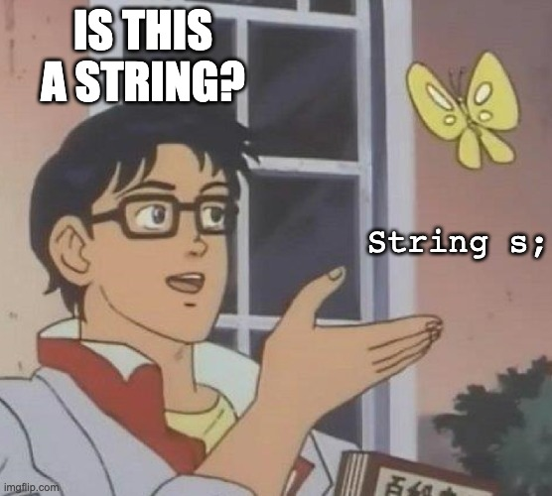
Reference Variables

Slide 22

Nope! It's a String reference to null!
s is a reference variable of type String.
A String reference, like all object references, either points to a String object instance, or is null
String s;
String s;
string.
s
null
s = "Hello, world!"; ← s started out null, but now points to a legit string
s
"Hello, world!"
String instance

Slide 23
null
null means nothing, no object is pointed to.
You can use null to check if a variable points to an object instance or not.
String s;
if (s == null) {
System.out.println("s doesn't exist!");
}
What's going on in memory here?
s
null

Slide 24
null
If you try usings methods or attributes of a null object reference, Java throws NullPointerException:
String s;
if (s.indexOf("a") >= 0) {
System.out.println(s + " contains an a"); ← throws NullPointerException
}
Some exceptions are not bugs in your program, like an exception thrown if the network is down.
But a NullPointerException usually means you need to fix your code.

Slide 25
null
How can you get around this? One way is to use Java's optimization of short-circuiting boolean expressions!
if (s != null && s.indexOf("a") >= 0) {
System.out.println(s + " contains an a");
}
If the left side of a && expression is false, Java will immediately cut out ahead of time. (Same for an || expression when the left side evaluates to true)
if (a && b) { … } if (a || b) { … }

Slide 26
null checks
Code like this that checks for null in Java is common.
if (s != null && s.indexOf("a") >= 0) { System.out.println(s + " contains an a"); }
However, your code should not check for null if there isn't a legitimate reason for a variable to be null. Reason about whether it should ever be null.
Don't litter your code with unnecessary null checks! This is actually what NullPointerException is for.
"Coding defensively" is good, but it is possible to code TOO defensively.

Slide 27
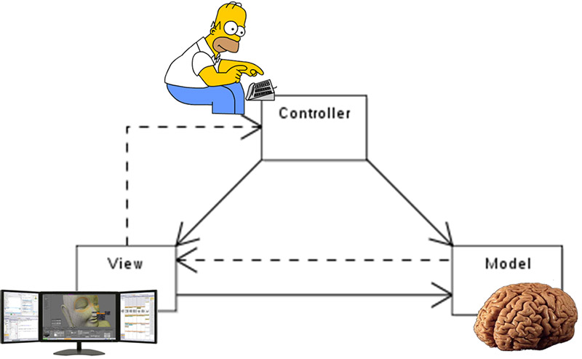
Concept in today's Replit: Model-View-Controller

Slide 28
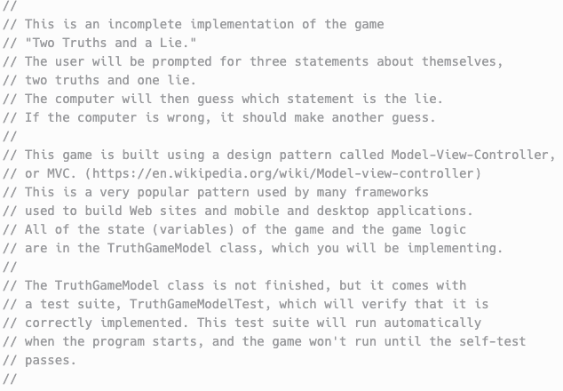
Practice!
Today's Repl.it will give you some else-if practice, and some boolean logic practice:
Repl: truthGame

